Slide 1
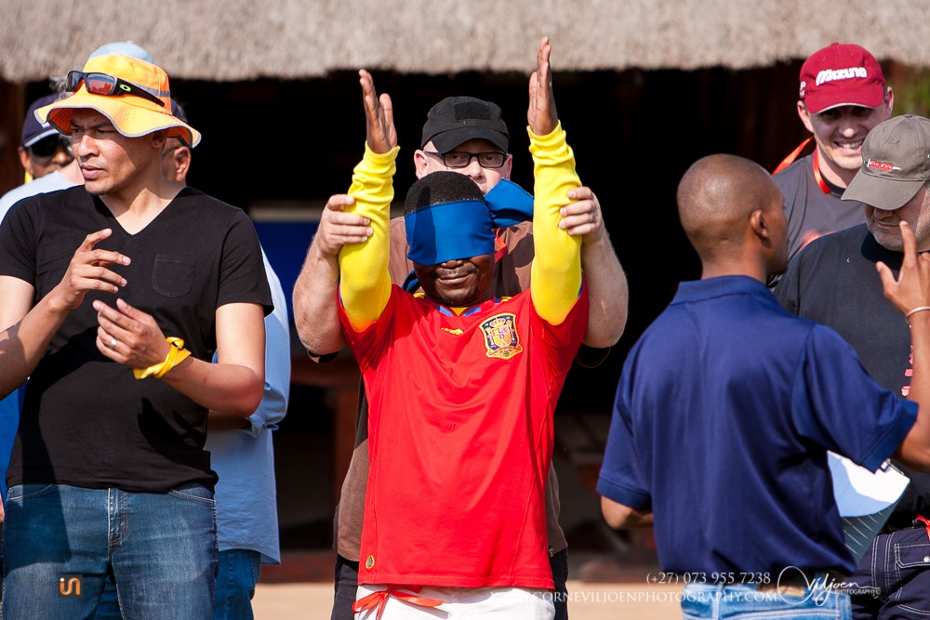
Team building designed to compliment any conference, function or excursion.
Team building programmes range from recreational- fun activities to Adventure sports and Team development.

Slide 2
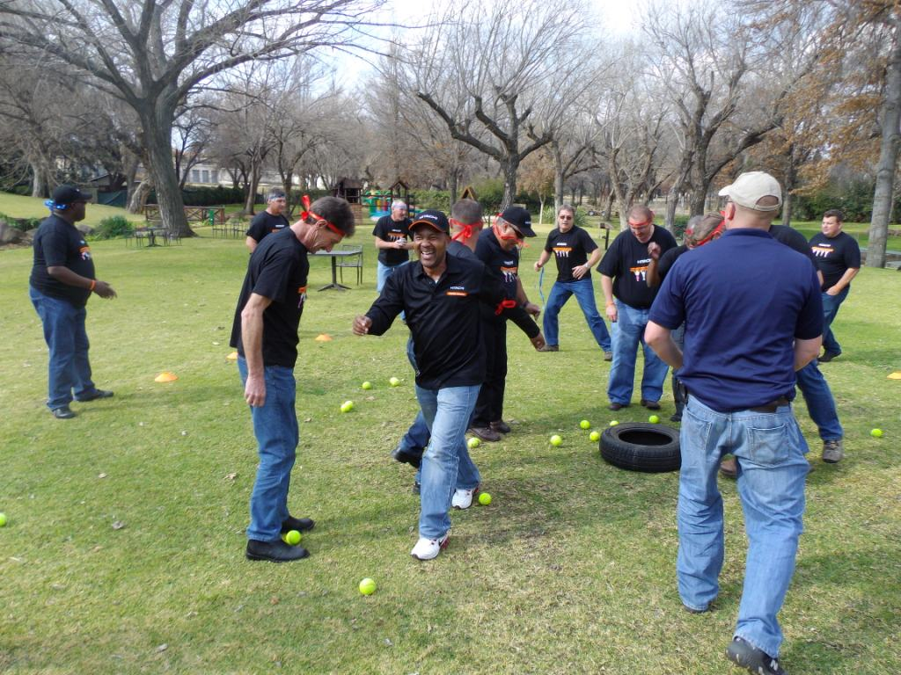
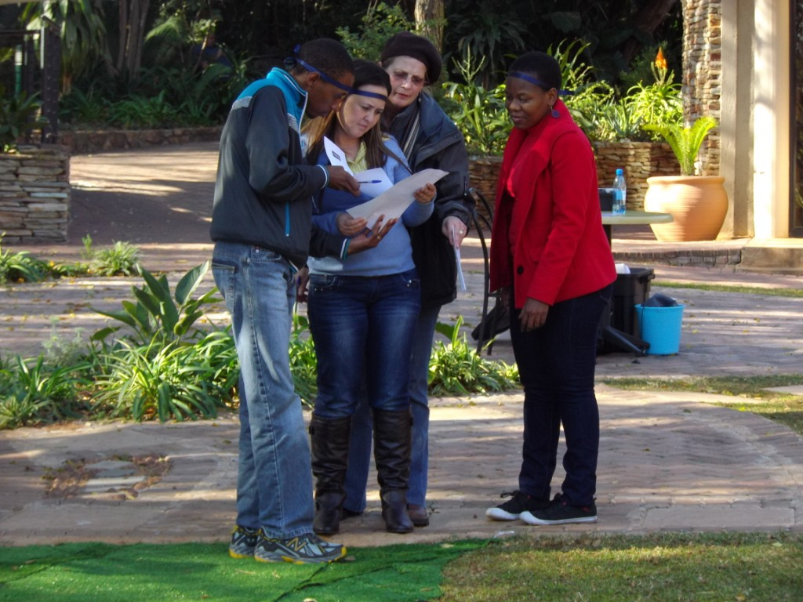
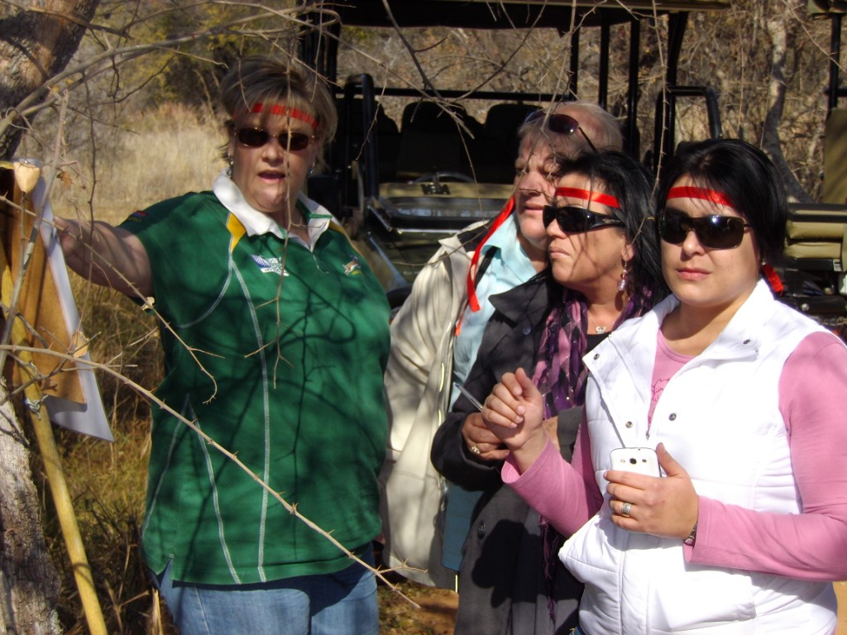
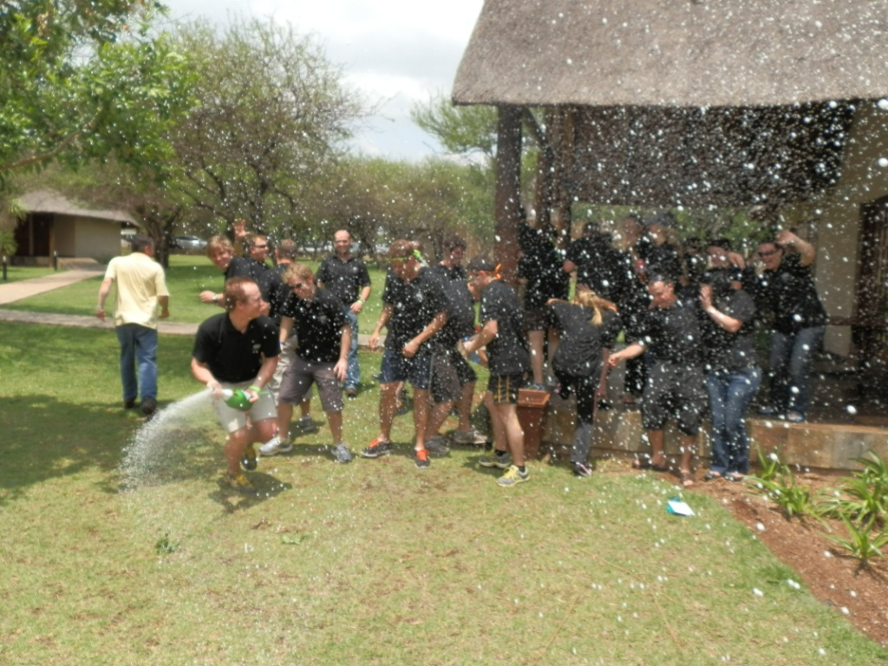

Slide 3
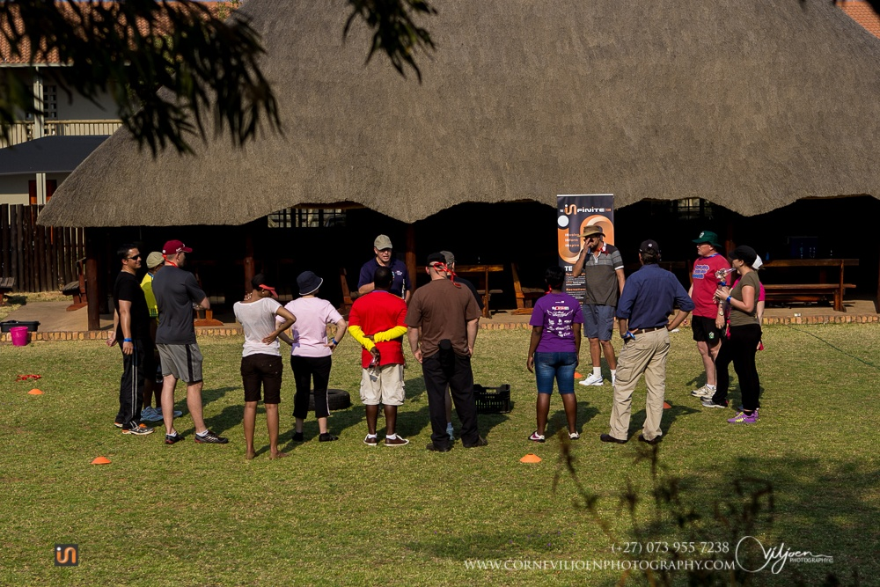
What is your teams desire?
Serious
Recreational
Adventure

Slide 4
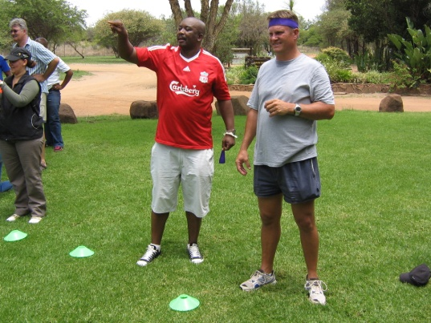
Serious Teambuilding
Programmes with specific outcomes
Providing a safe environment to open communication within the team
Making use of experiential learning activities
Outcome : Gaining methods to resolve issues within the working environment

Slide 5
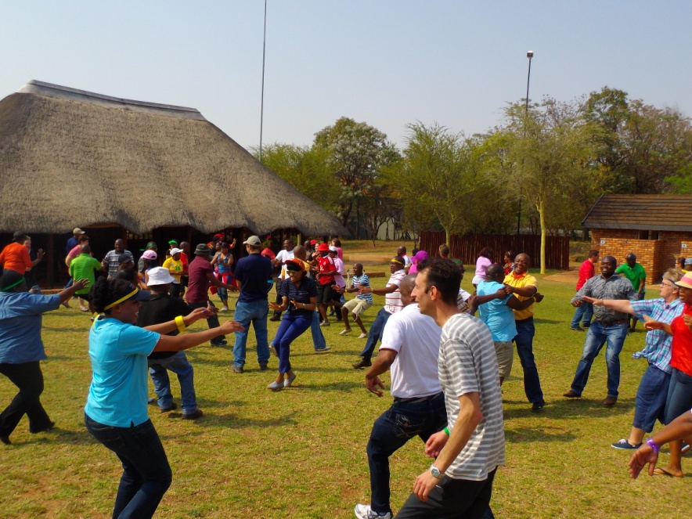
Recreational activities
Programmes to compliment a conference or function with fun activities
Activities are structured to match the theme of the day
Tailor made activities
Outcome : Create positive team spirit

Slide 6
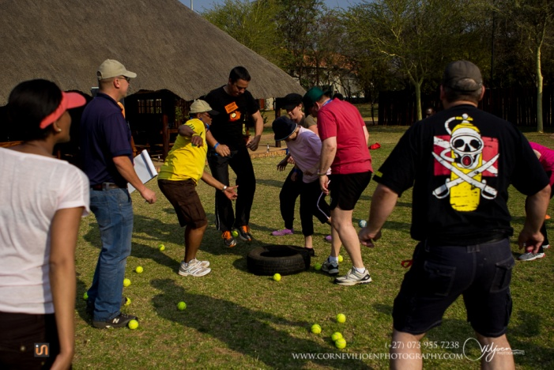
Adventure activities
Programmes to get team out of their comfort zones
Team mates get to know one another better on another level
Fun challenging activities
Outcome : Replacing every day stress with a fun filled, adventurous time away from work

Slide 7
Programs
Eco safari challenge
Diamond rush
Infinite Challenge
Amazing race
CSI – Cluedo
Archery
Raft building
Sugar escapes
Family days
Win it in a minute
Fun entertainment
Eco Golf
Cocktail creations
Top Chef cook outs

Slide 8
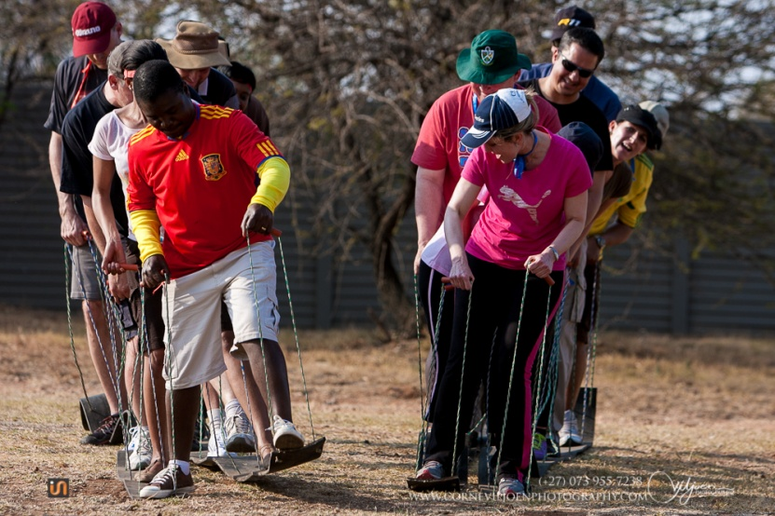
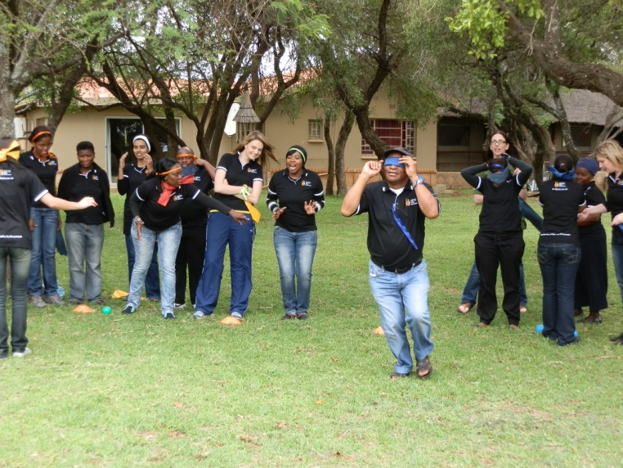
Infinite Challenge
Activities for groups between 8-200 guests
Competing in various activities
Get everyone involved
Fun & adventure

Slide 9
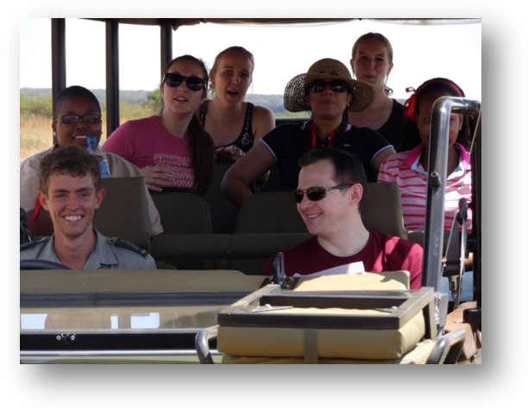
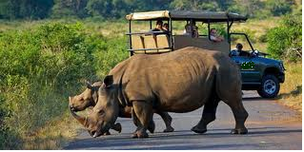
Eco safari challenge
Game viewing with a difference
Teams competing while gaining knowledge
Scoring points
Conquering the safari challenge

Slide 10
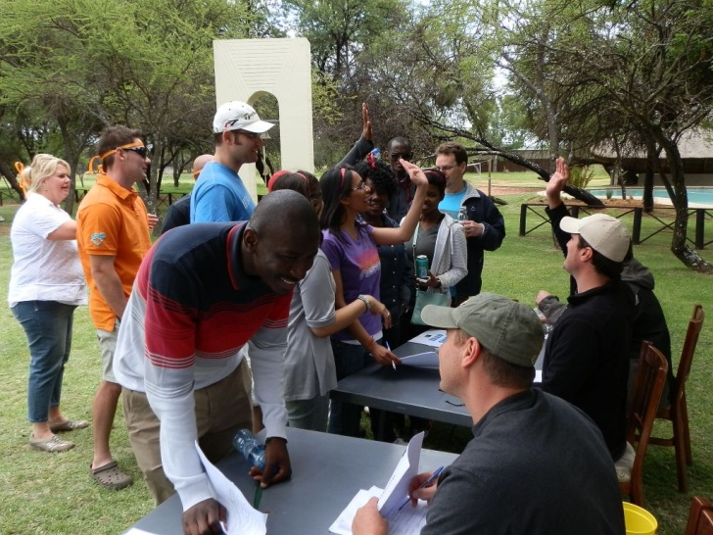
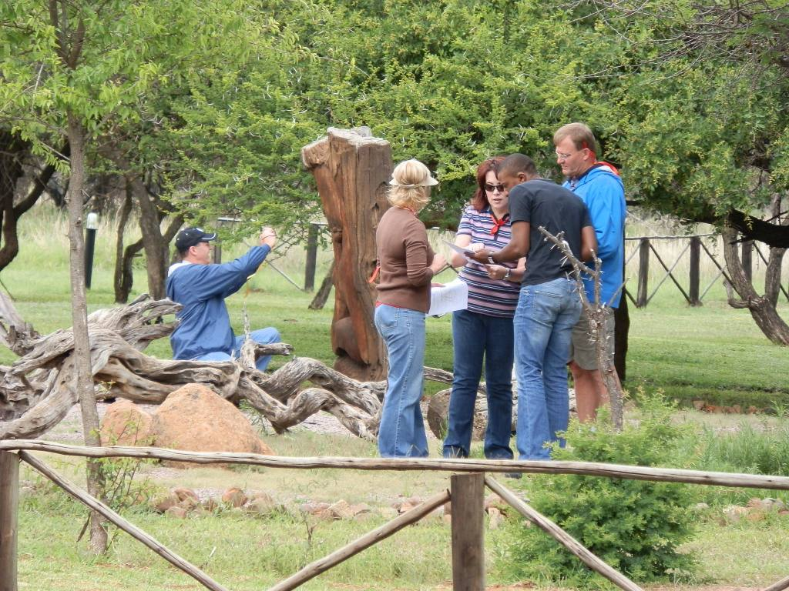
Infinite expedition
Getting out, getting active
Great positive team competition
Clues and navigation
Banking diamonds
Earning points
Winning team

Slide 11
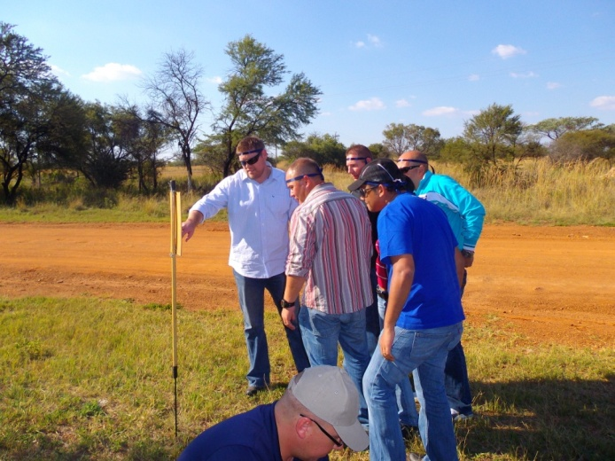
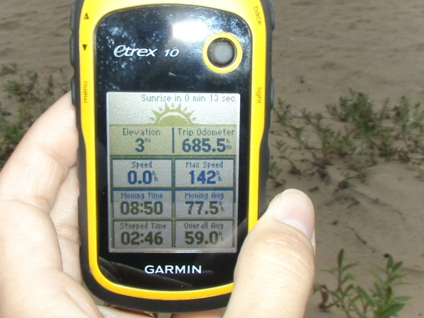
Amazing race
The race start at the clients office
Clues and instructions
Pit stops at places of interest
Navigation to the secretly booked venue
Great way of finding your conference venue

Slide 12
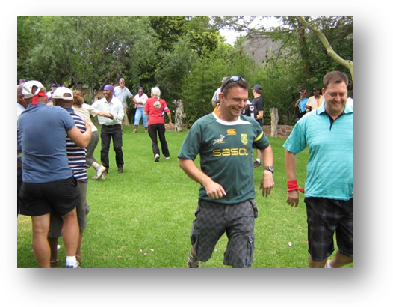
Family days
Adult and kids stations
Various activities at different stations
Whole day ‘carnival” fun
Family participates in activities at their own leisure

Slide 13
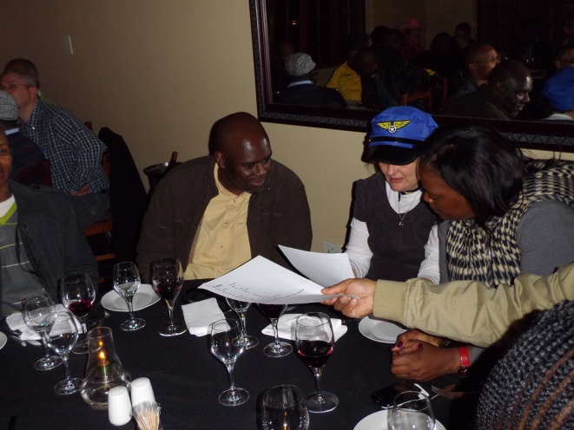
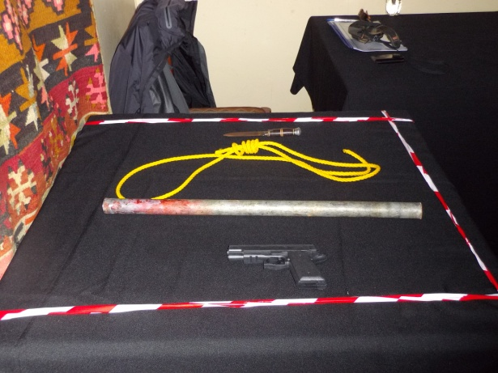
CSI – Cluedo
Your task as a team is to solve a crime scene
Investigate the crime scene
Find evidence
Means, motive and opportunity
Building a solid case

Slide 14
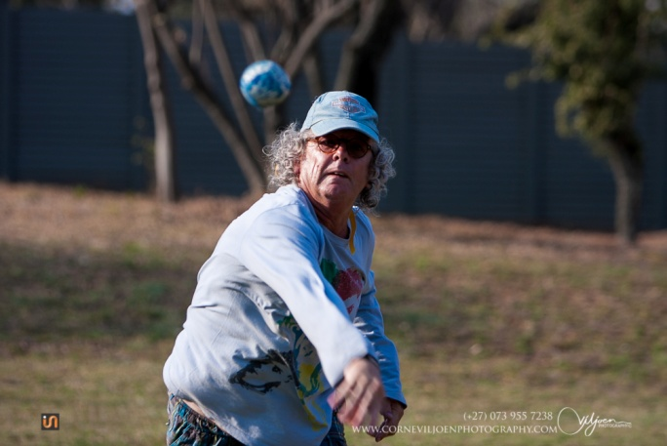
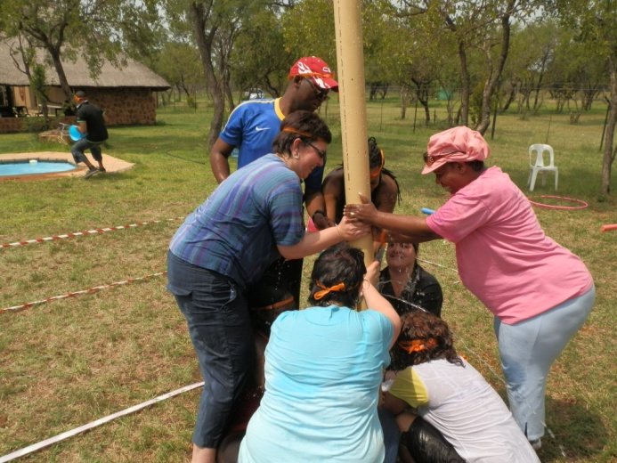
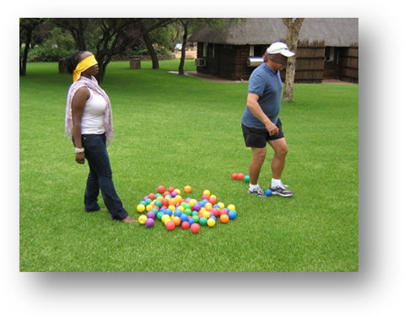
Crazy Olympics
Blind balls (fun game played with colour coded balls)
Water sports fill the leaking pipe, raging river and many more
Wheel barrow, 3 legged and bag racing
The crazy race (participant’s race against one another completing tasks and crossing obstacles)

Slide 15
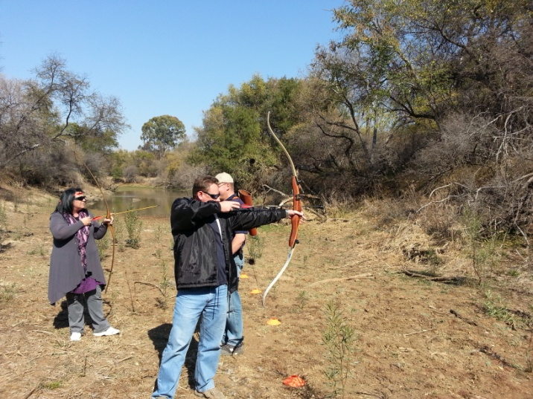
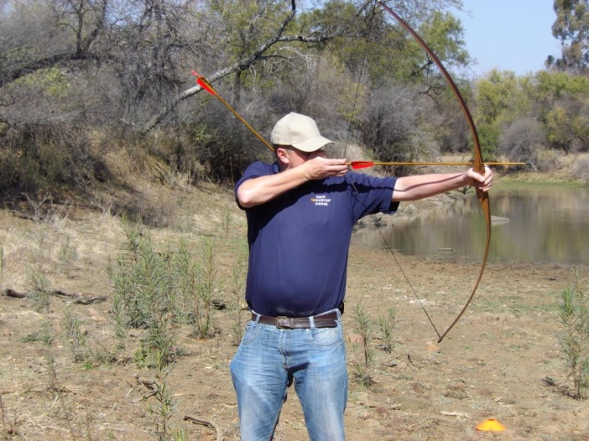
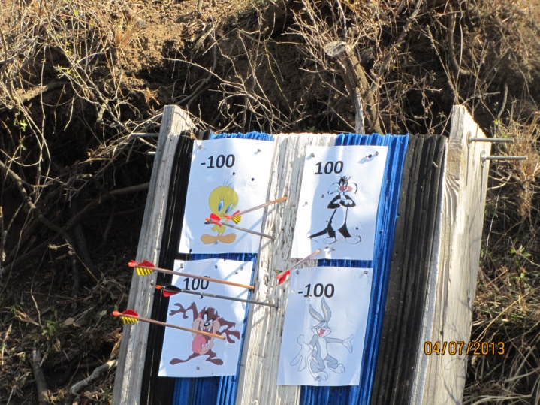
Archery
Traditional archery (long bows)
Basic intro in handling, and aiming with a long bow
Discover who has a natural talent with this age old weapon

Slide 16
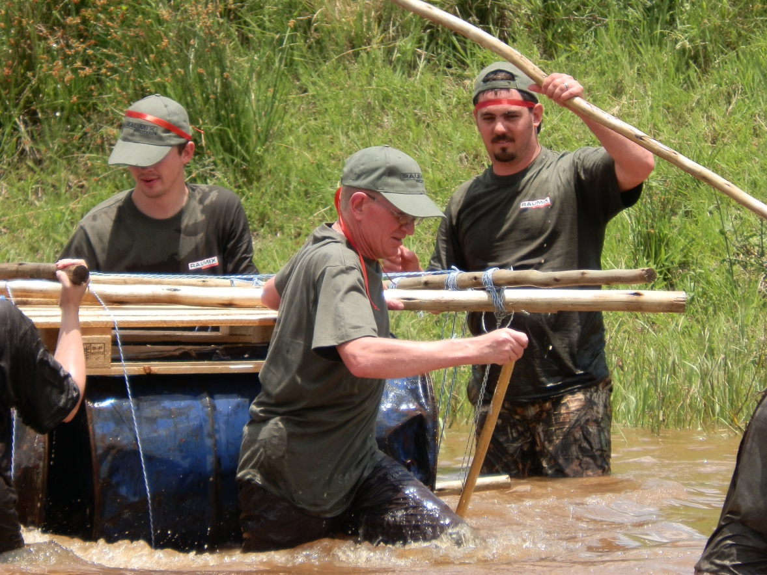
Raft building
Cryptic clues to locate equipment
Build a steady raft!!!
Raft race

Slide 17
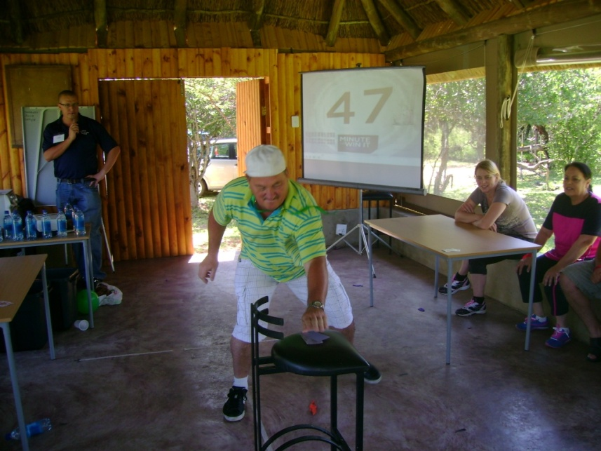
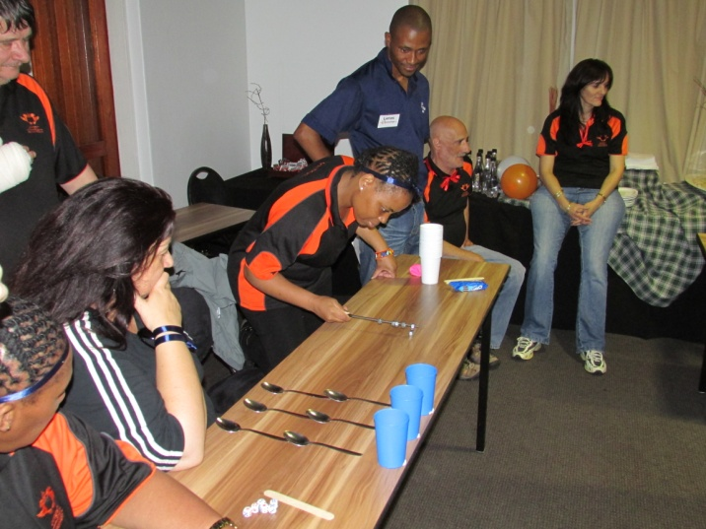
Win it in a minute
Based on popular TV show (Minute to win it)
Teams competing against one another
Using household, office and variety of everyday objects
Positive team spirit

Slide 18
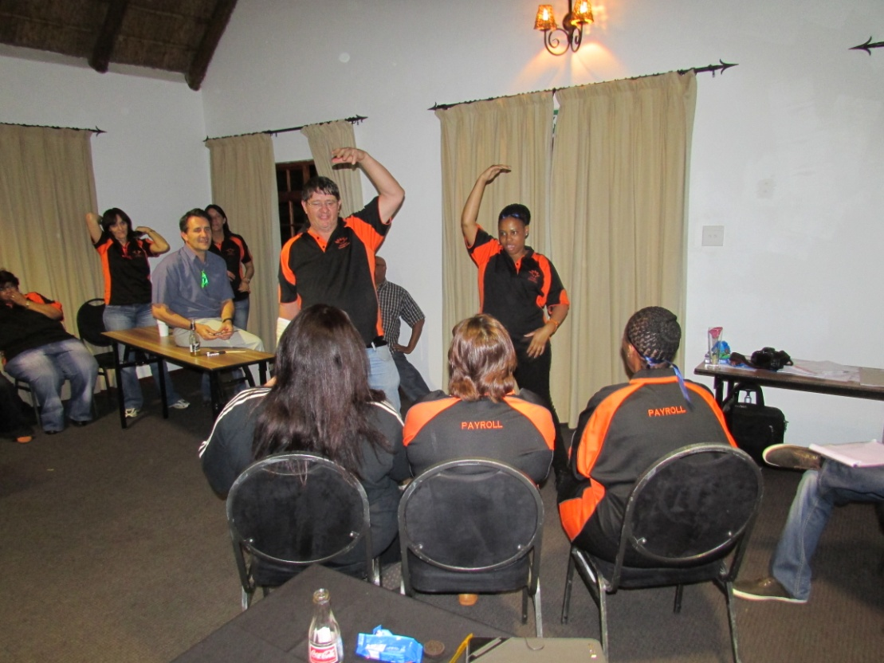
Fun entertainment
Can be presented day or night
Can be anything from a music montage, 30 sec, or movie festival

Slide 19
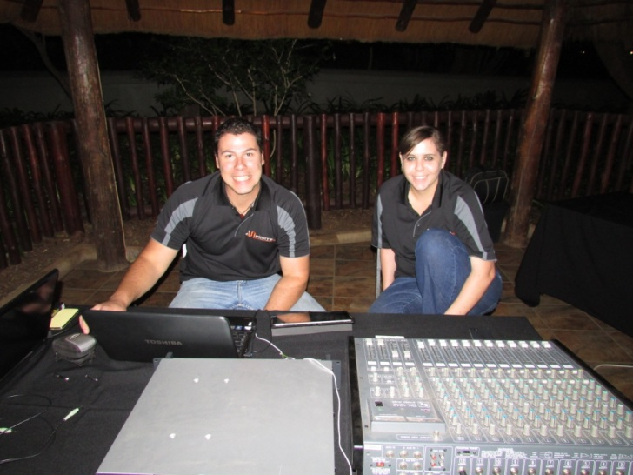
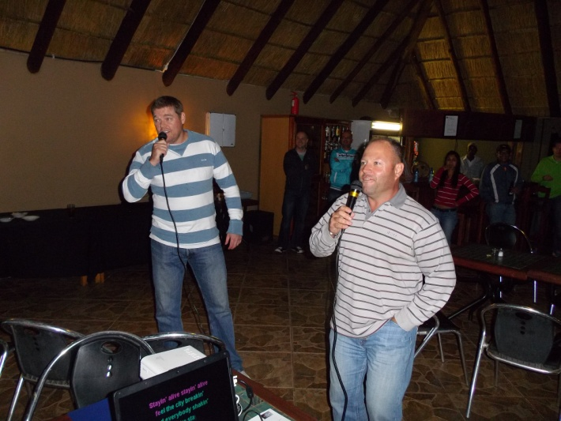
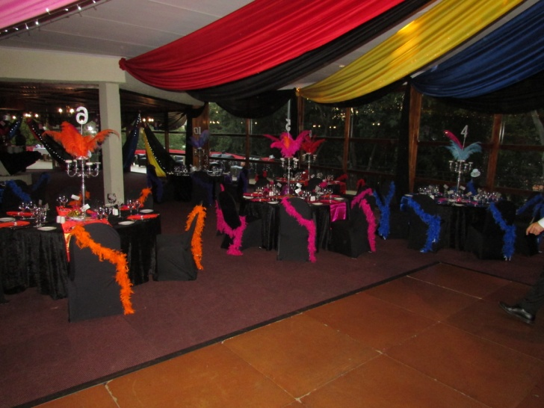
SOUND
DJ Infinite
Karaoke

Slide 20
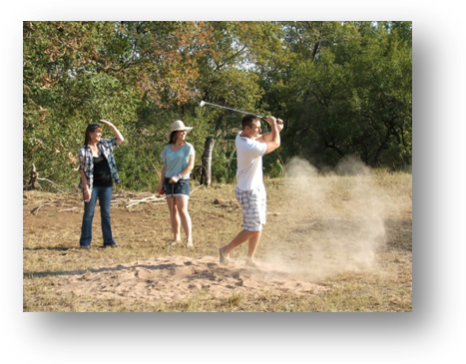
Eco Golf
Varied tasks and challenges are built into the Eco Golf course
Roadblock’ e.g. problem solving
Obstacle Crossing’ individual choice for point accumulation

Slide 21
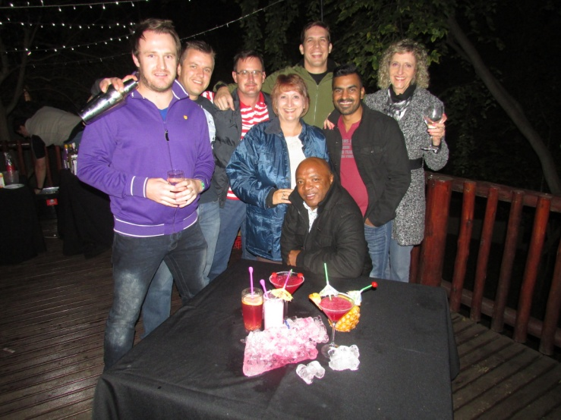
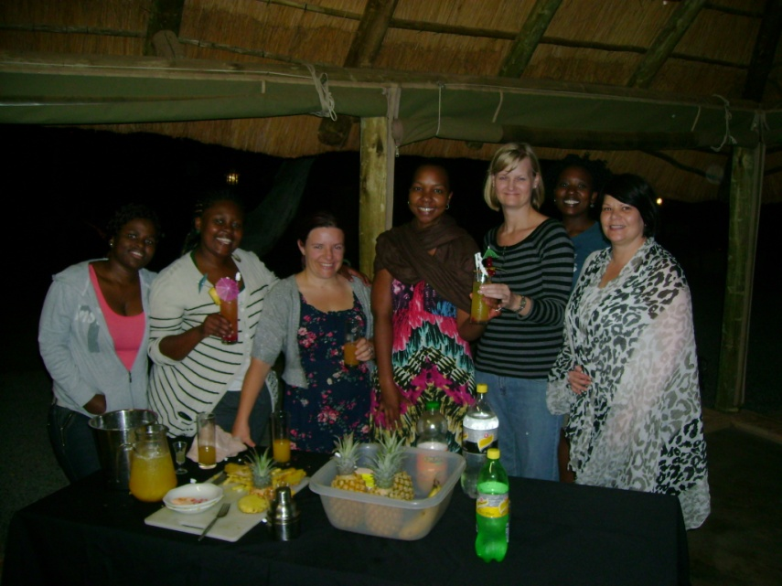
Cocktail creations
Create a cocktail using your teams expertise
Some spirit, mixers, sugar, honey, milk or cream to name a few
Blend it together
Let the judging commence

Slide 22
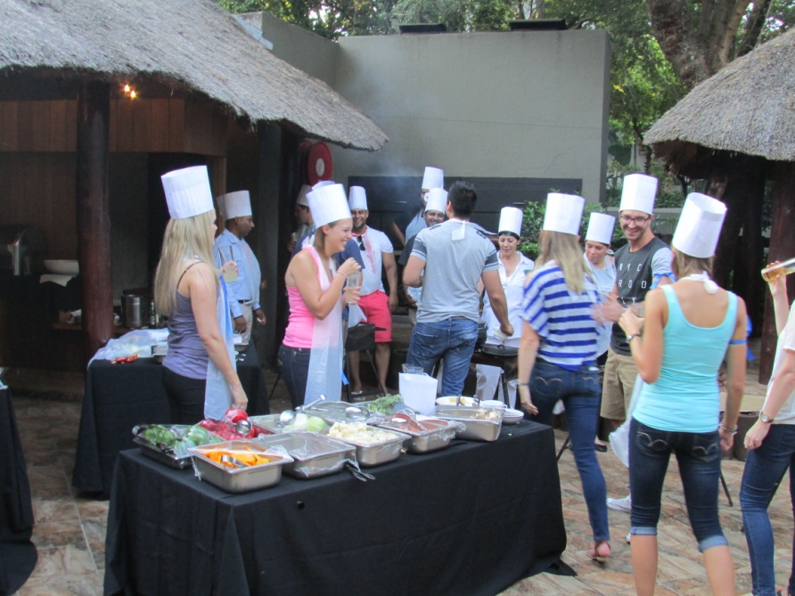
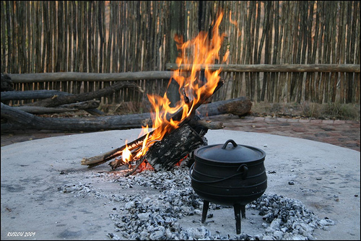
Top Chef cook outs
Potjiekos competition
Breakfast run
Secret ingredients & ancient recipes
All boils down to who’s the top chefs

